Slide 1

Introduction to HTML

Slide 2
Introduction
Web developers view a web page as a document that must be created according to authoring and development guidelines
Web developers use HTML(HTML5) to write code of a web page
Web browsers have a built-in interpreter to render the results of a code in its window

Slide 3
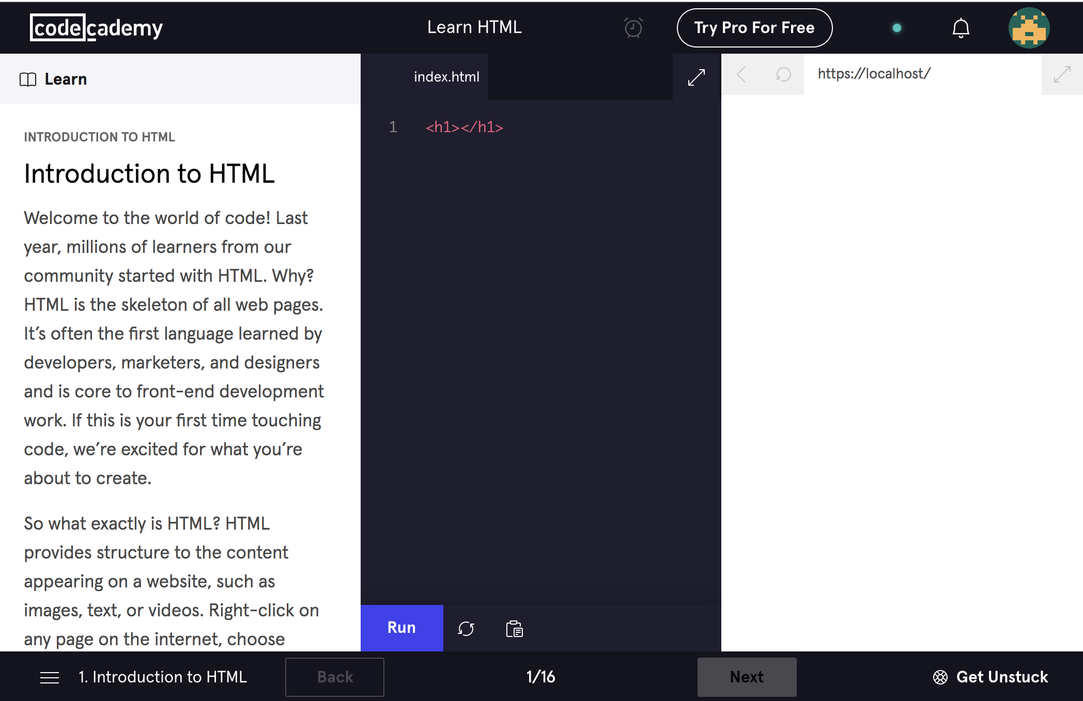
Resources – Code Academy
https://www.codecademy.com

Slide 4
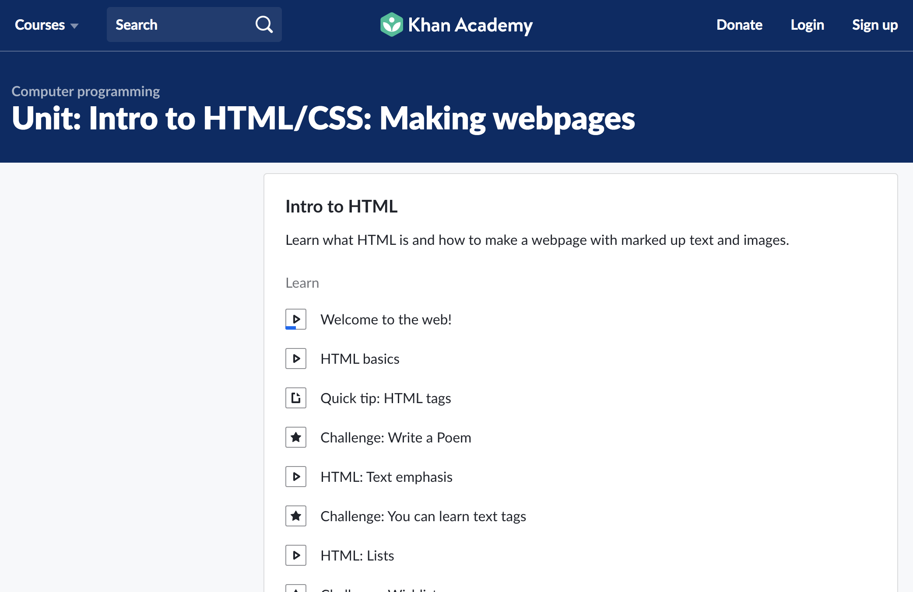
Resources – Khan Academy
https://www.khanacademy.org

Slide 5
The World Wide Web
Definitions (W3C)
HTML
The HyperText Markup Language
The language used to design web pages
XHTML
The eXtensible HyperText Markup Language
Intended to enhance HTML, not replace it
HTML5
Builds upon previous versions of the markup language to provide greater flexibility and control over websites.

Slide 6
Content of Web Pages
The content of a web site can be classified as:
Static content – does not change regularly e.g. personal and professional web sites
Dynamic content – changes regularly e.g., banking web sites, weather reports…

Slide 7
Authoring of Web Pages
After a web page is designed one needs to use HTML code to author a web page

Slide 8
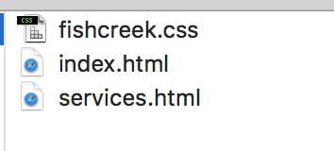
How does this work?
If I double click on this, I see what this web page looks like.
If I right-click and open with something like Notepad++, I can see and alter the code.
If I double click on this, I see the CSS code which is the code for styling the page. I can edit it here.
When I am happy with all of my code, I can host it on a webserver so that it can be viewed on the internet.
…..

Slide 9
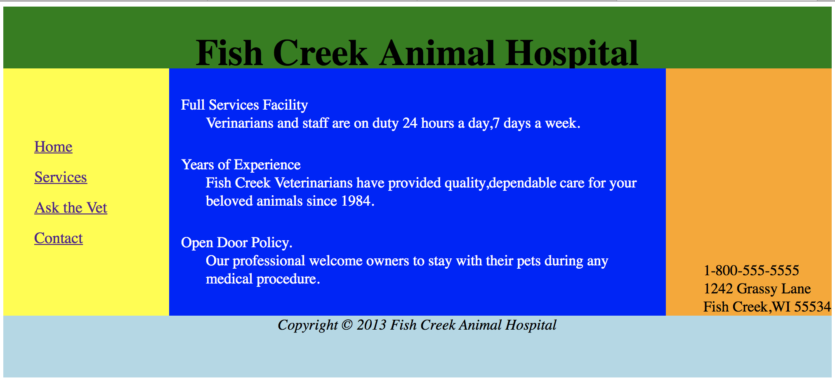
HTML
HTML is made of:
Text content – what you see
Markup – what it looks like
Reference to other documents e.g, images, pdfs
Links to other pages

Slide 10
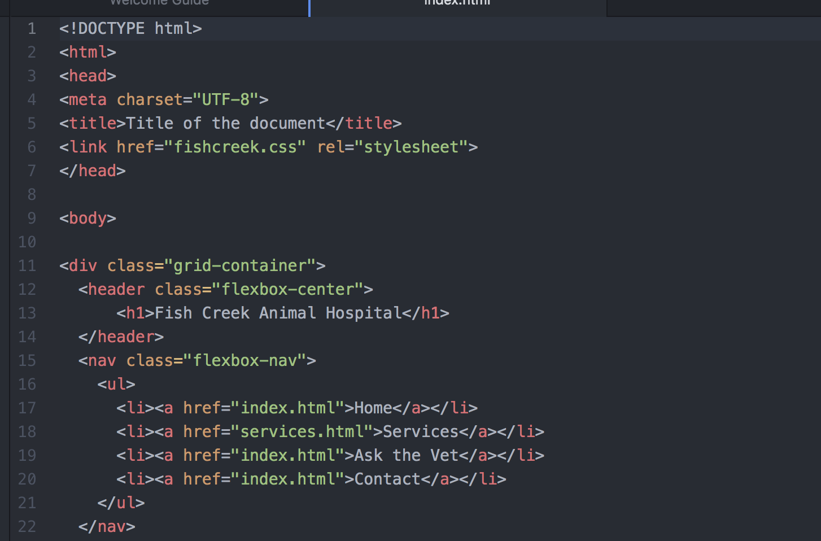
Starting HTML – a tag
<name> Contents </name>
Opening tag
Closing tag

Slide 11
Syntax
Tags are enclosed in brackets (<,>)
Content is enclosed between the tags
Tags and content form look as follows:
<start-tag>content<end-tag>

Slide 12
Structural tags are mandatory
<!DOCTYPE html>
<html>
<head>
Styling, metadata…. goes here
</head>
<body>
Web page content goes here
</body>
</html>

Slide 13
<b></b> Make content bold

Slide 14
First tag - <b></b>
Description:
<b> Contents </b>
Implementation:
<b>TU259 is the code of this course</b>
Output:
TU259 is the code of this course

Slide 15
What happens if you forget to close <b> tag ?
All text is bold
No text is bold
The page does not render

Slide 16
<em></em> Emphasises content by using italics

Slide 17
<em></em>
Description:
<em> Contents </em>
Implementation:
<em>TU259 is the code of this course</em>
Output:
TU259 is the code of this course

Slide 18
Exercise
Write the code that would have the following output:
TU259 is the code of this course

Slide 19
<a></a> Used to link web pages together

Slide 20
HTML Attributes
<tag attr=“value”> Contents </tag>

Slide 21
HTML Attributes - <a></a>
Anchor - <a> - link
<a href=“https://www.tudublin.ie/> Overview of TU Dublin</a>
attribute
value

Slide 22
<a></a>
Description:
<a href = “…”> ….</a>
Implementation:
<a href=“https://tudublin.ie
”> Overview of TUDublin</a>
Output:
Overview of TUDublin

Slide 23
Hyperlinks
Anchors are <a> tags to link different sections of the same web page
2 uses of anchors are for table of contents and eliminating scrolling
Creation of anchor requires 2 <a> tags
<a name=“sale”> and <a href=“#sale”>

Slide 24
Hyperlinks - anchors
<a name="Contents">Table of Contents</a>
<a href="#Contents"> Return to Table of Contents</a>

Slide 25
<img> Defines an image

Slide 26

<img> - VOID tag
Description:
<img src = URL alt = text>
Implementation:
<img src=“TUdublinlogo.jpg” alt=“TU Logo”>
Output:
For accessibility
Broken request

Slide 27
Exercise
Write the code that would make the following image (Tudublinlogo.jpg) a link to the TU Dublin website:

Slide 28
<br> Used when you need to break a line prematurely

Slide 29
<br> - VOID tag
Description:
<br>
Implementation:
TU Dublin is Ireland's first Technological University.<br> With campuses in Dublin City, Tallaght and Blanchardstown, it spans the largest population centres of ...
Output:
TU Dublin is Ireland's first Technological University.
With campuses in Dublin City, Tallaght and Blanchardstown, it spans the largest population centres of ...

Slide 30
<p></p> Main textual blocks

Slide 31
<p></p>
Description:
<p></p>
Implementation:
<p>TU Dublin is Ireland's first Technological University. </p>
<p>With campuses in Dublin City, Tallaght and Blanchardstown, it spans the largest population centres of ... </p>
Output:
TU Dublin is Ireland's first Technological University.
With campuses in Dublin City, Tallaght and Blanchardstown, it spans the largest population centres of ...

Slide 32
<p></p>
<p>This a paragraph of text in a HTML document</p>
Line space
This a paragraph of text in an HTML document

Slide 33
<p></p>, <br>
<p>This a paragraph of text in an HTML document</p>
<p>This a 2nd paragraph of text in an HTML document</p>
This a paragraph of text in an HTML document
This a 2nd paragraph of text in an HTML document
<p>This a paragraph of text in an HTML document</p>
<br/>
<p>This a 2nd paragraph of text in an HTML document</p>
This a paragraph of text in an HTML document
This a 2nd paragraph of text in an HTML document

Slide 34
<title></title> The title of the web page

Slide 35
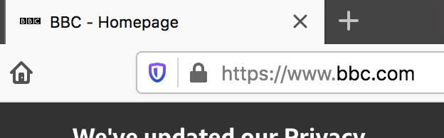
<title></title>
Description:
<title> This is the title you want to appear on the browser</title>
Implementation:
<title>BBC - Homepage</title>
Output:

Slide 36
<h1></h1> …<h6></h6> Headings

Slide 37
Headings
There are 6 levels of headings <h1>…..<h6>, the higher the heading number the smaller the text
<h1> Heading 1</h1>
<h2> Heading 2</h2>
<h3> Heading 3</h3>
<h4> Heading 4</h4>
<h5> Heading 5</h5>
<h6> Heading 6</h6>
Heading 1
Heading 2
Heading 3
Heading 4
Heading 5
Heading 6

Slide 38
Exercise
Write the code which would produce the following output:
Academic Calendar
The standard TU Dublin academic
calendar is available
online at
http://www.dit.ie/academicaffairsandregistrar/calendar/

Slide 39
<hr> Horizontal rules appear as lines across the user agent screen

Slide 40
<hr>
Description:
<hr>
Implementation:
A line should be drawn under this text
<hr>
Output:
A line should be drawn under this text

Slide 41
<div> </div> Format a large block of text in a similar fashion

Slide 42
<div></div>
Description:
<div></div>
Implementation:
<div style=”text-align:center"> Text formatted using div tag
</div>
Output:
Text formatted using div tag
This will go into a CSS file!

Slide 43
<ol> </ol> <ul> </ul> <dl> </dl> Lists

Slide 44
Lists
HTML supports 3 types of lists:
Ordered – <ol>
Unordered – <ul>
Definition – <dl>
Lists may be nested to obtain multiple hierarchy levels

Slide 45
Ordered List - <ol>
Lists whose elements must appear in a certain order
Such lists usually have their items prefixed with a number or letter
<ol>
<li>Apples</li>
<li>Bananas</li>
<li>Coconuts</li>
</ol>
Apples
Bananas
Coconuts

Slide 46
Ordered List - <ol>
How can the numbering style be changed??
Some other style options:
decimal
lower-roman
upper-roman
upper-alpha
<ol style=“list-style-type: lower-alpha”>
<li>Apples</li>
<li>Bananas</li>
<li>Coconuts</li>
</ol>
a. Apples
b. Bananas
c. Coconuts

Slide 47
Unordered List - <ul>
Lists whose elements do not have to appear in a certain order
<ul>
<li>Apples</li>
<li>Bananas</li>
<li>Coconuts</li>
</ul>
Apples
Bananas
Coconuts

Slide 48
Unordered List - <ul>
How can the list item marker be changed??
Some other style options:
disc
circle
none
<ul style=“list-style-type: square”>
<li>Apples</li>
<li>Bananas</li>
<li>Coconuts</li>
</ul>
Apples
Bananas
Coconuts

Slide 49
Definition List - <dl>
More complex than the other 2 lists due to their having 2 elements per list item
<dl>
<dt>Internet Explorer</dt>
<dd>Developed by Microsoft</dd>
<dt>Netscape</dt>
<dd>Developed by Netscape</dd>
</dl>
Internet Explorer
Developed by Microsoft
Netscape
Developed by Netscape

Slide 50
Definition(Description in HTML5) List - <dl>
<dl>
<dt>Internet Explorer</dt>
<dd>Developed by Microsoft</dd>
<dt>Netscape</dt>
<dd>Developed by Netscape</dd>
</dl>
Internet Explorer
Developed by Microsoft
Netscape
Developed by Netscape

Slide 51
Exercise:
Write the code which would produce the following output:
Send us a letter, including:
Your full name
Your order number
Your contact information
Use the web form to send an email

Slide 52
<video> Used to incorporate video files (HTML5)

Slide 53
<video>
Description:
<video>
Implementation:
<video height="60" volume="70” controls>
<source src="music.mp4" type=”video/mp4”>
</video>
Output:
A picture of the media file

Slide 54
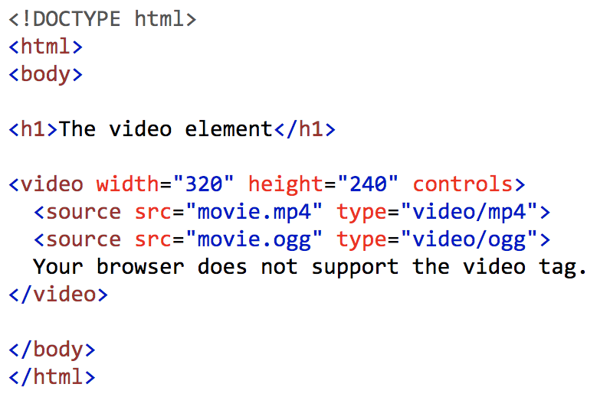
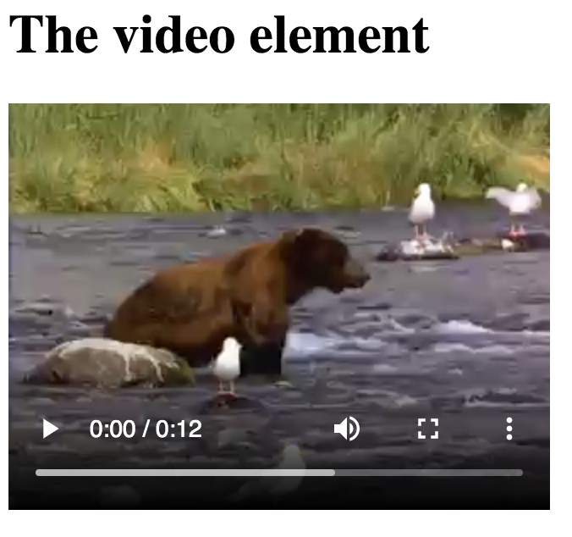
<video> - sample
Courtesy of w3schools - http://www.w3schools.com/tags/tryit.asp?filename=tryhtml5_video

Slide 55
<embed> Used to incorporate audio and video files

Slide 56
<embed> - VOID tag
Description:
<embed>
Implementation:
<embed src="music.mp3" width="145” height="60" volume="70">
Output:
A picture of the media file

Slide 57
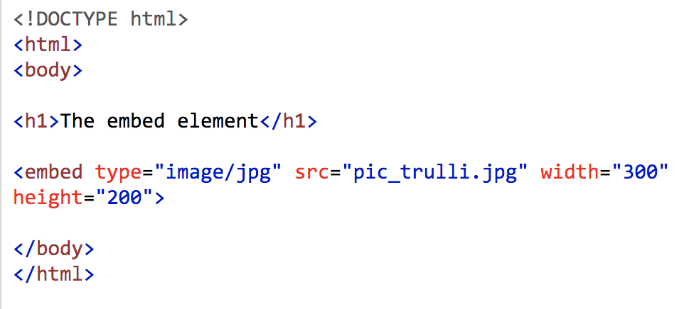
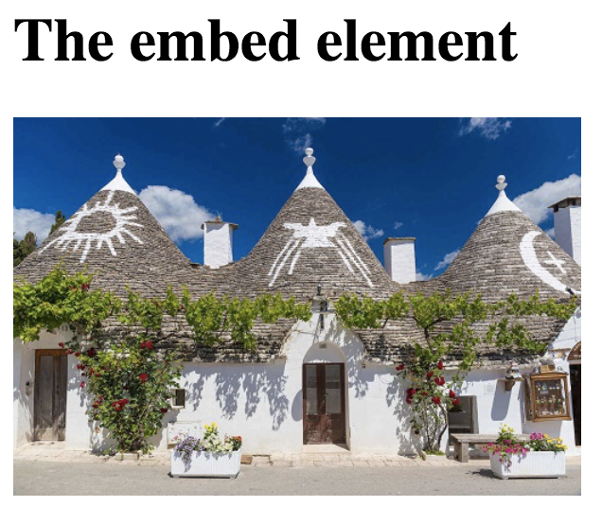
<embed> - sample
Courtesy of w3schools - http://www.w3schools.com/tags/tryit.asp?filename=tryhtml5_embed

Slide 58
Some rules/guidelines
Document Structure
DOCTYPE is mandatory
<html>, <head>, <title>, and <body> is mandatory
Elements
Elements must be properly nested
Elements must always be closed
Elements must be in lowercase
Documents must have one root element
Attributes
Attribute names must be in lower case
Attribute values must be quoted
Comments can be used
Escaped characters are used
Do not use deprecated or obsolete tags
Browsers ignore mis-spelled tags

Slide 59
Where do all of these tags go?

Slide 60
HTML5 Document Structure
<!DOCTYPE html>
<html>
<head>
<title> HTML5 Document Structure </title>
<meta charset="utf-8">
</head>
<body>
Web page content goes here
</body>
</html>
HTML5 template - https://drive.google.com/open?id=1fuMydY72NMCIns4czJmLSkdO2ioiNVd9&authuser=450273%40dit.ie&usp=drive_fs

Slide 61
Document Tags
The tags that make up the framework of a typical HTML document include the following:
Document type tag – DOCTYPE
<!DOCTYPE html>
Top-level tag, generally <html>
Tag indicates the beginning and end of an HTML5 document

Slide 62
Document Tags - Header
Header section, delimited by <head> tags
Provides extra information about the document
Serves as a container such as styles and global scripts

Slide 63
Document Tags - Body
Body section, delimited by <body> tags
Section where visible content appears
Content is a series of block tags containing inline content

Slide 64
How can I write my first web page?
Download html5template.html from Week 1 folder in Brightspace
Open this file in a text editor e.g., Notepad
Save it as Example1.html
HTML5 template - https://drive.google.com/open?id=1fuMydY72NMCIns4czJmLSkdO2ioiNVd9&authuser=450273%40dit.ie&usp=drive_fs

Slide 65
Good resources
https://www.w3schools.com/
https://www.lynda.com/
https://teamtreehouse.com/
https://www.freecodecamp.org/
https://stackoverflow.com/

Slide 66
Reference
HTML5 documentation – http://www.w3.org/TR/html-markup

